Slide 1

IDP: Surgical Phase Recognition Using Deep Learning Methods
Haotong Wang
Technische Universität München
TUM School of Computation, Information and Technology
Munich, 10. April 2025

Slide 2
Motivation
Surgical procedures involve multiple stages that require precise coordination and execution
Workflow detection automation is crucial
Context-aware system in future OR → improve efficiency in OR
Facilitating automated postoperative documentation and analysis

Slide 3
Main Objective
Most DL models are trained and evaluated with laparoscopic surgery videos
→ adapt those DL models to detect surgical phase of ophthalmological surgery

Slide 4
Literature Review
Oh, we can capture temporal feature differently!
EndoNet (CNN based)
MS-TCN (Multi-Stage Temporal CNN)
ViT!
time
Temporal feature?
SV-RCNet (CNN + LSTM)
Transformer Based Method
Surgical Stage as Graph
Dynamic Scene Graph Representation

Slide 5
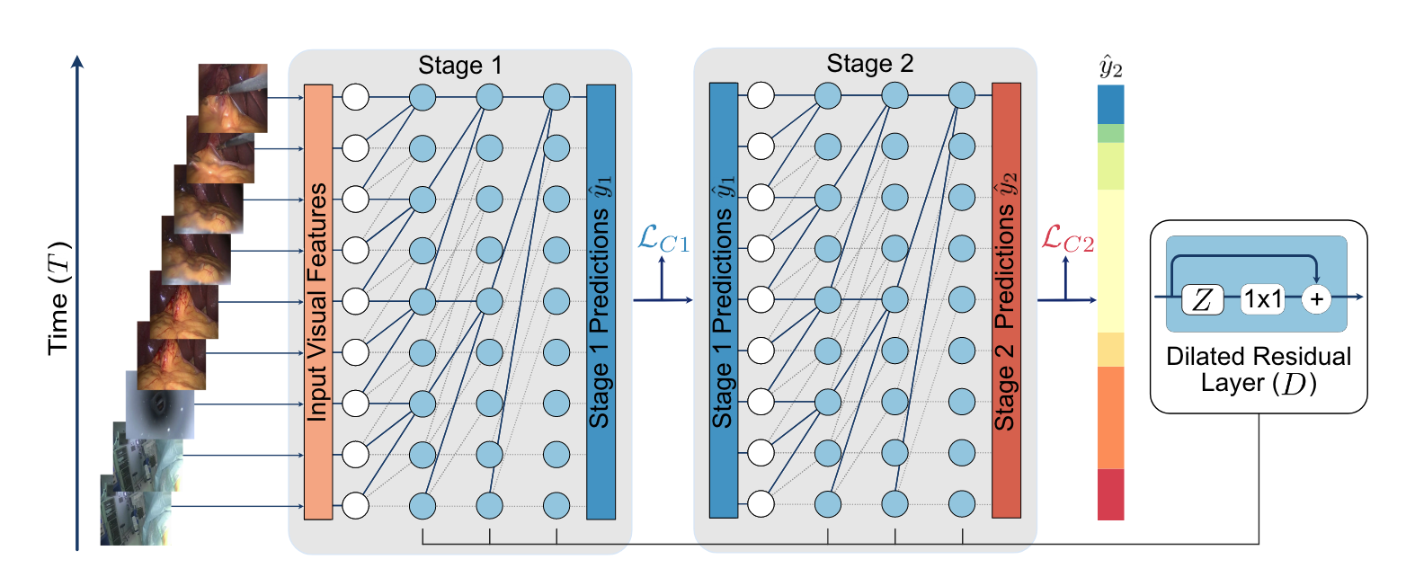
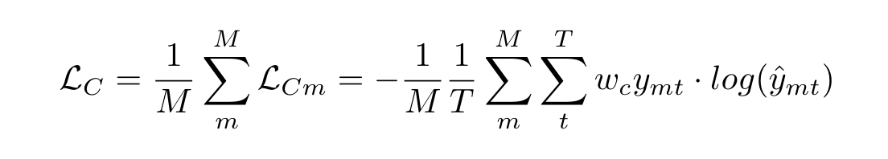
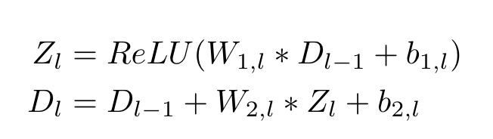
TeCNO
Czempiel, T., Paschali, M., Keicher, M., Simson, W., Feussner, H., Kim, S., & Navab, N. (2020). “Tecno: Surgical phase recognition with multi-stage temporal convolutional networks.” International Conference on Medical Image Computing and Computer-Assisted Intervention (MICCAI), 343–352.
TCNs consist of hierarchical
dilated convolutions and residual
layers
Causal convolution
Multi-stage refinement of the result
TCNs outperform LSTMs

Slide 6
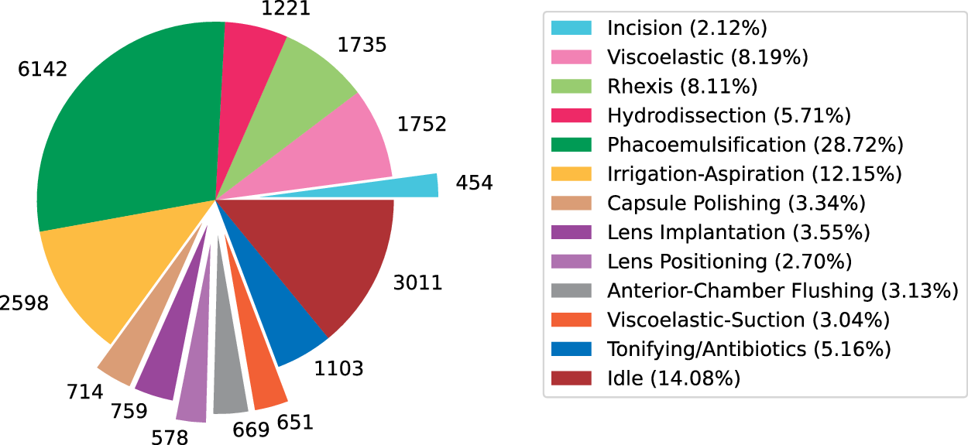
Cataract1k
N. Ghamsarian et al., “Cataract-1K Dataset for Deep-Learning-Assisted Analysis of Cataract Surgery Videos,” Sci Data, vol. 11, no. 1, p. 373, Apr. 2024, doi: 10.1038/s41597-024-03193-4.

Slide 7
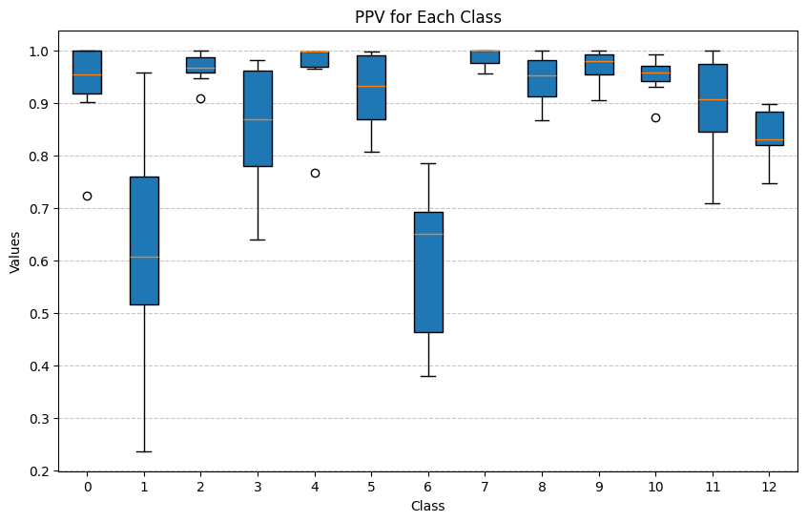
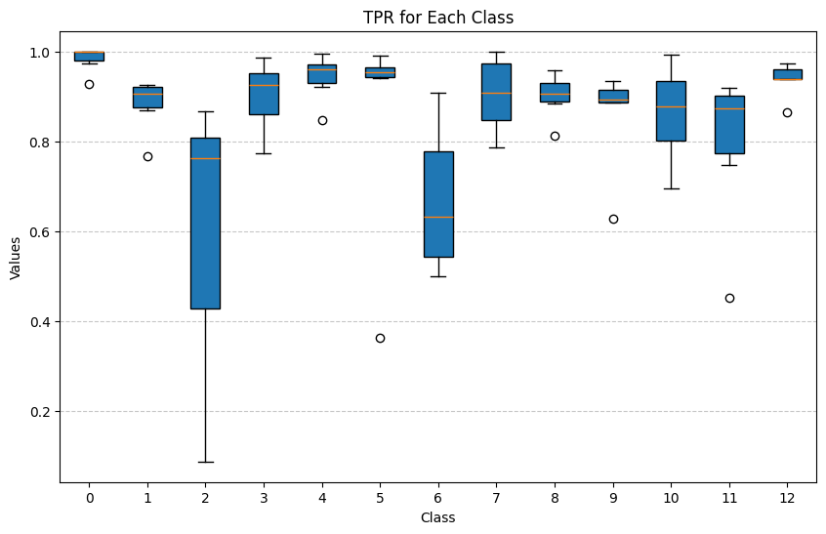
ResNet50 as sole phase recognizer

Slide 8
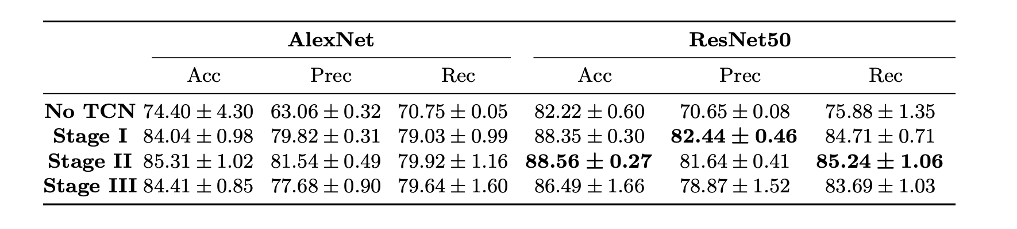

Performance Metrics of ResNet50
Video-level:
Average Accuracy: ~89.03% $±$ 4.32
Average F1-Score: ~85.14% $±$4.01
Stage-level:
Average stage-level precision: ~87.70%$±$ 15.8
Average stage-level recall: ~85.36%$±$ 16.9
Original Paper:
Haotong Wang (TUM) | IDP

Slide 9
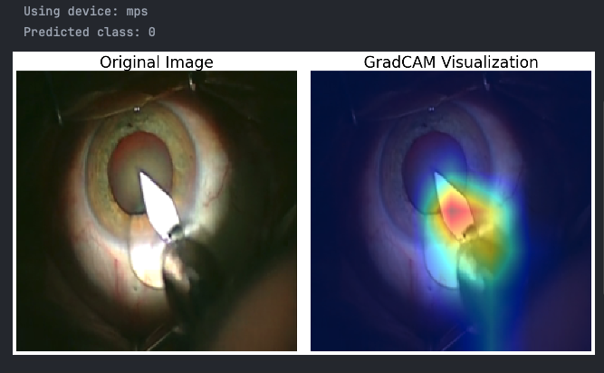
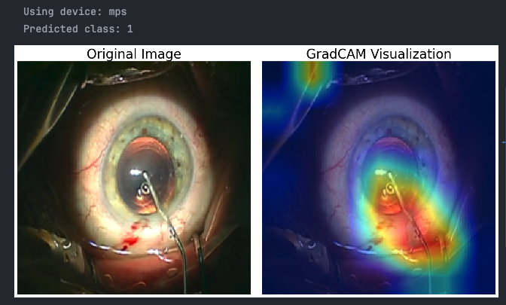
GradCAM
Ground Truth: 0
Ground Truth: 1

Slide 10
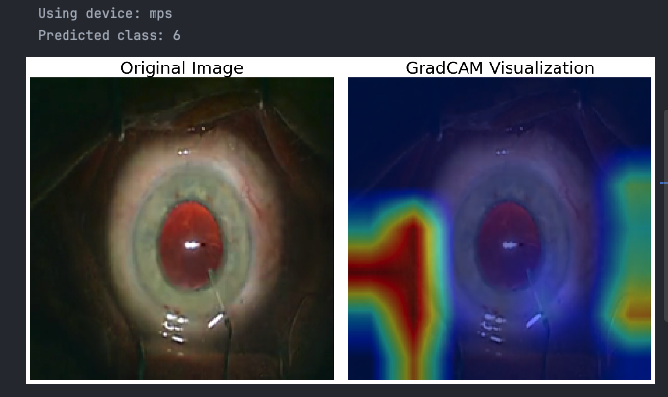
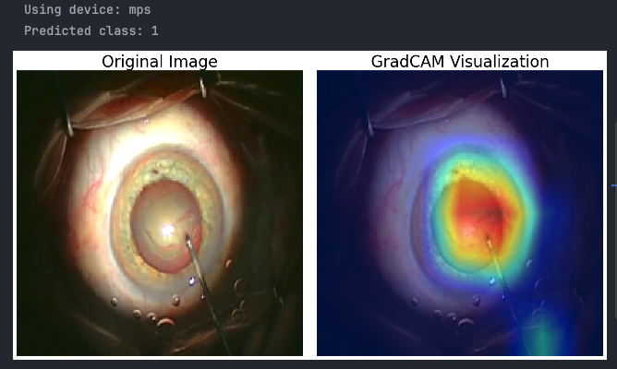
Unexpected cases
Ground Truth: 6
Ground Truth: 2

Slide 11
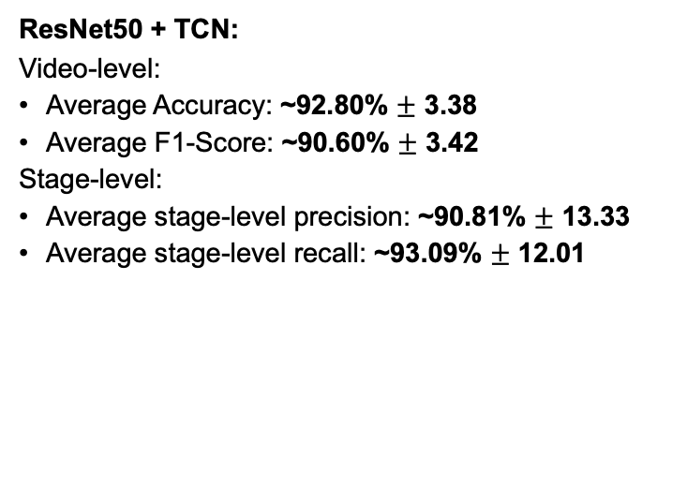
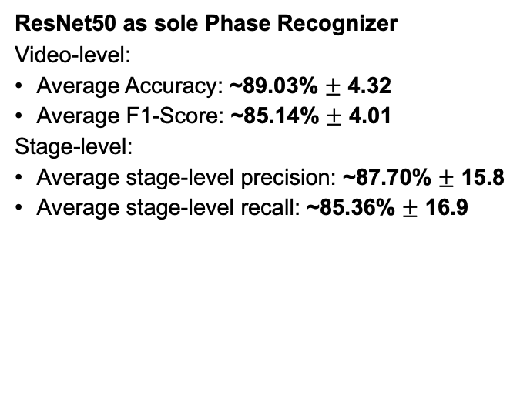
Performance Metrics of ResNet50 + TCN
ResNet50 as sole Phase Recognizer
Video-level:
Average Accuracy: ~89.03% $±$ 4.32
Average F1-Score: ~85.14% $±$ 4.01
Stage-level:
Average stage-level precision: ~87.70% $±$ 15.8
Average stage-level recall: ~85.36% $±$ 16.9
ResNet50 + TCN:
Video-level:
Average Accuracy: ~92.80% $±$ 3.38
Average F1-Score: ~90.60% $±$ 3.42
Stage-level:
Average stage-level precision: ~90.81% $±$ 13.33
Average stage-level recall: ~93.09% $±$ 12.01
Original Paper:
Haotong Wang (TUM) | IDP

Slide 12
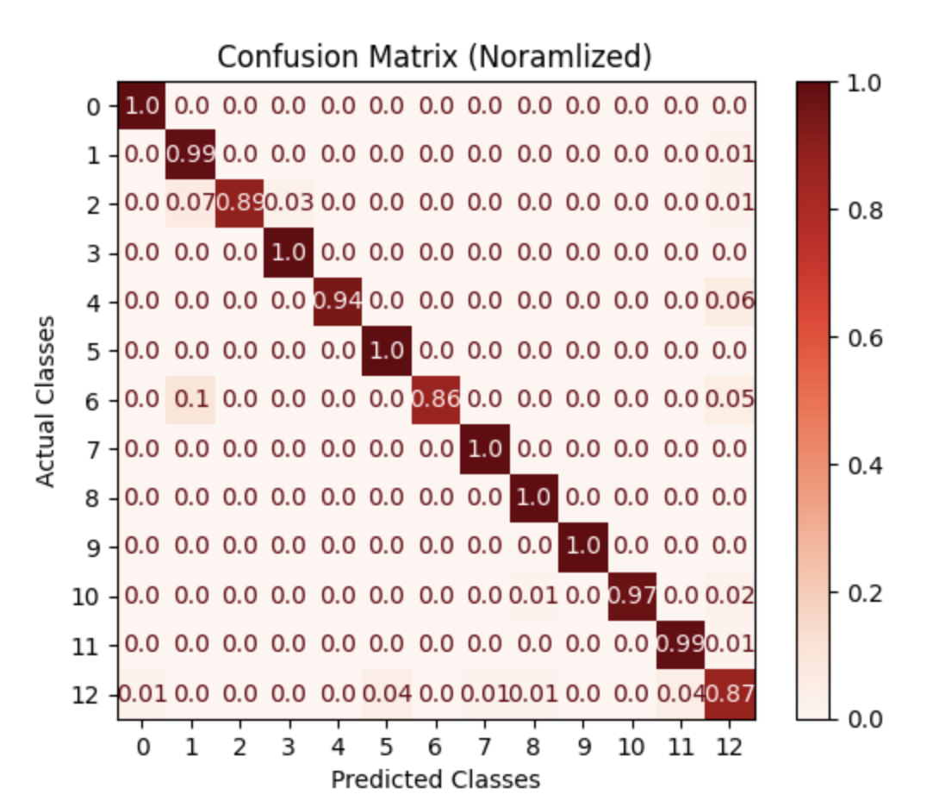
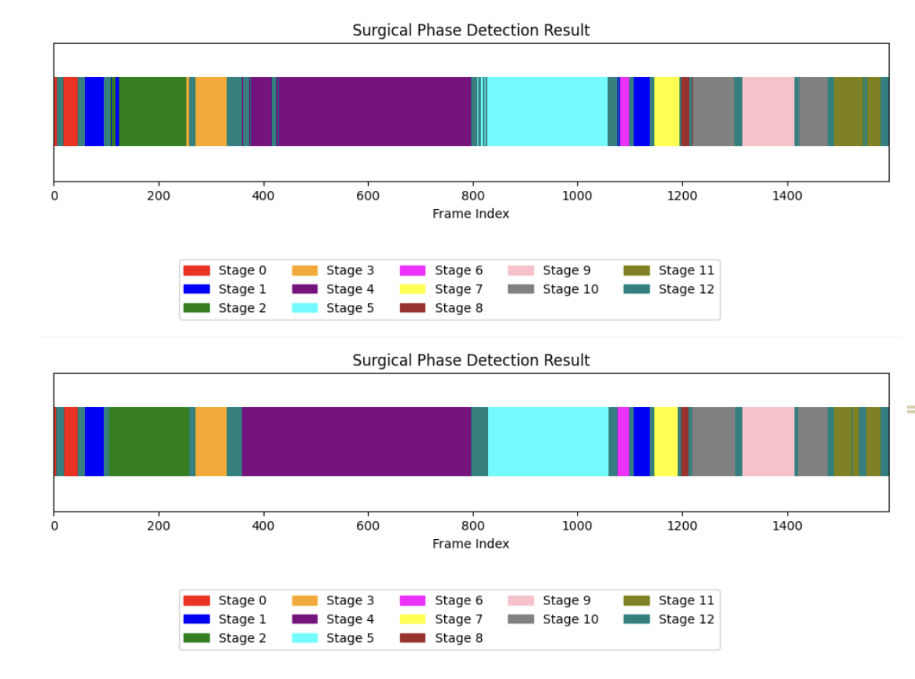
Qualitative Analysis
Model Output
Ground Truth
Haotong Wang (TUM) | IDP

Slide 13
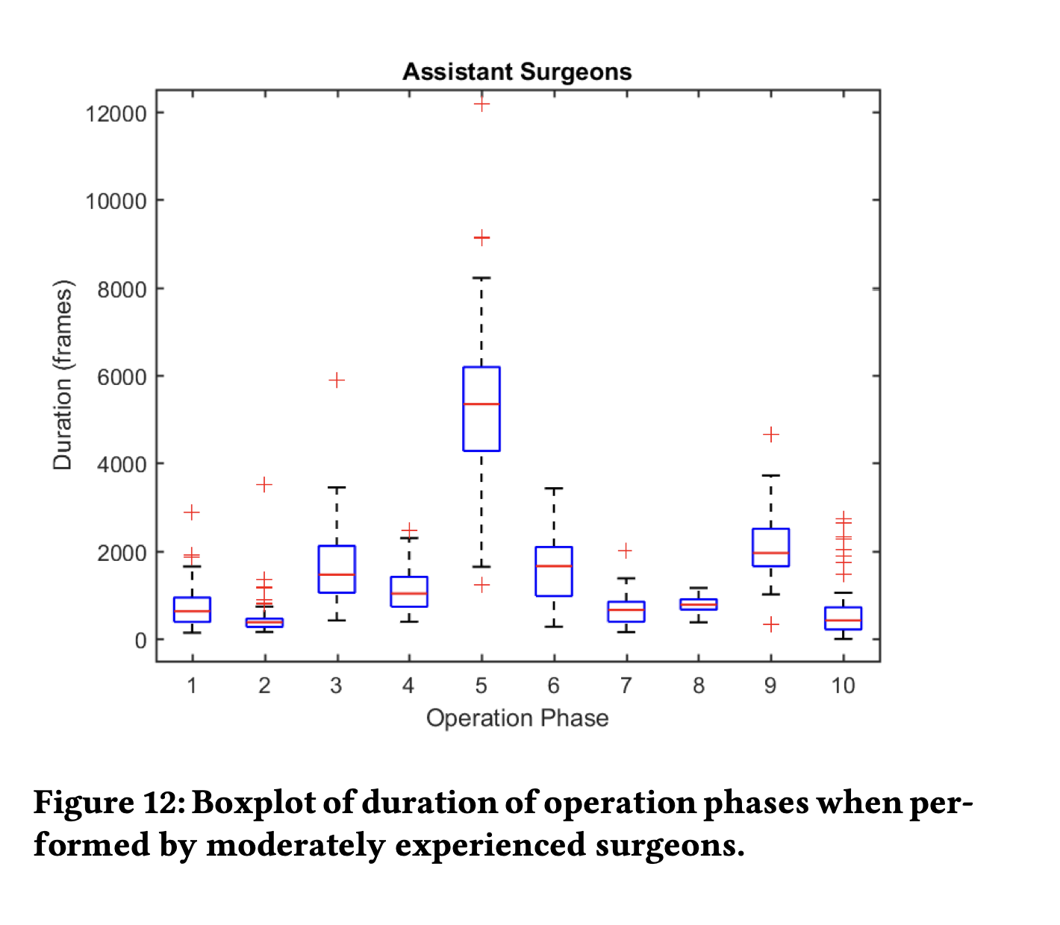
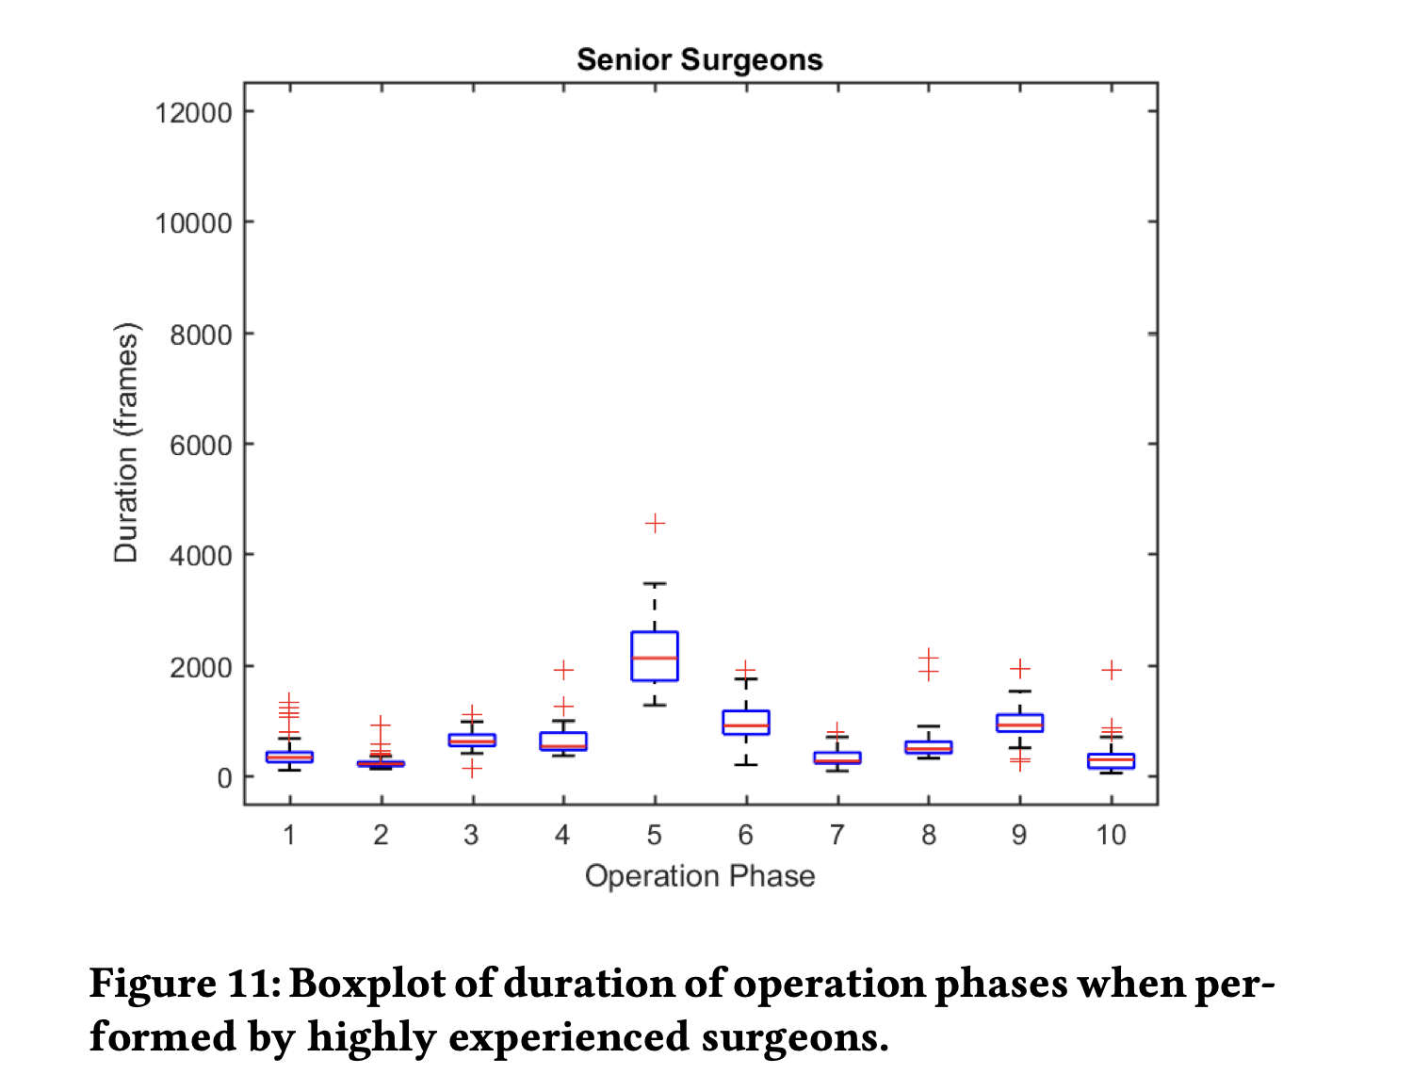
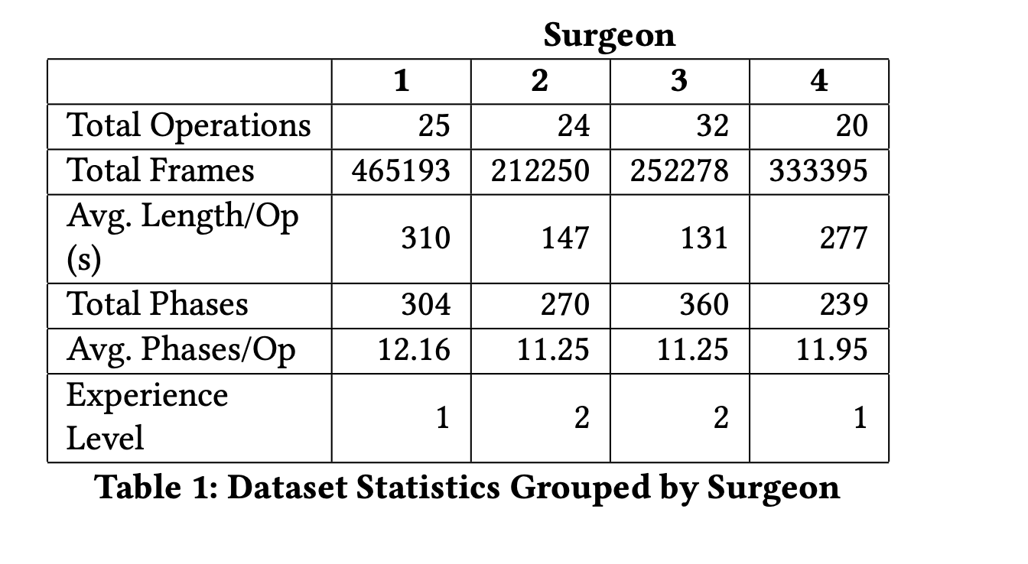
Cataract-101
101 surgery videos performed by four different surgeons (two senior surgeons + two assistant surgeons) over a period of 9 months
10 stages in total
Haotong Wang (TUM) | IDP

Slide 14
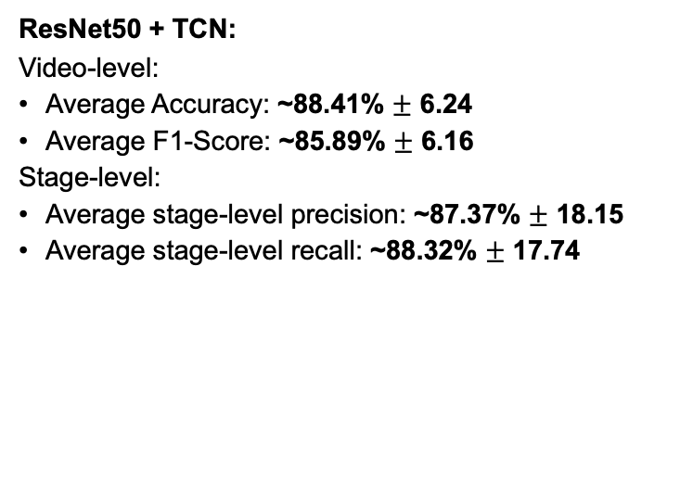
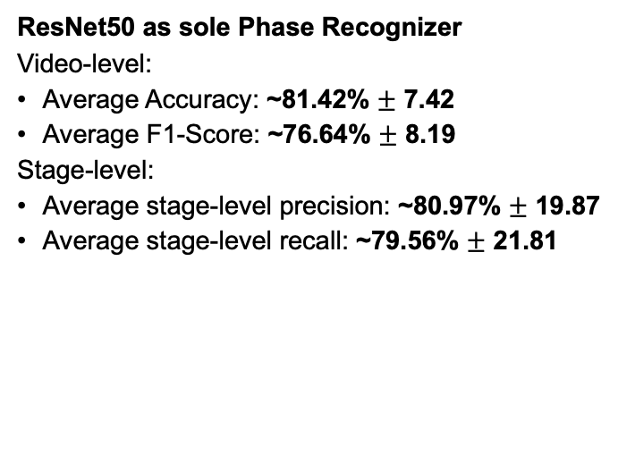
Model Performance on Cataract-101
ResNet50 as sole Phase Recognizer
Video-level:
Average Accuracy: ~81.42% $±$ 7.42
Average F1-Score: ~76.64% $±$ 8.19
Stage-level:
Average stage-level precision: ~80.97% $±$ 19.87
Average stage-level recall: ~79.56% $±$ 21.81
ResNet50 + TCN:
Video-level:
Average Accuracy: ~88.41% $±$ 6.24
Average F1-Score: ~85.89% $±$ 6.16
Stage-level:
Average stage-level precision: ~87.37% $±$ 18.15
Average stage-level recall: ~88.32% $±$ 17.74
Haotong Wang (TUM) | IDP

Slide 15
High variance in stage-level metrics
class imbalance
experience-based variability, inter-surgeon variability and intra-surgeon variability
data distribution of training set and test set
different nature of surgeries compared to laparoscopic surgeries
1 Incision 2 Viscous Agent Injection
3 Rhexis 4 Hydrodissection
5 Phacoemulsificiation 6 IrrigationAndAspiration
7 CapsulePolishing 8 Lens Implant Setting Up
9 ViscousAgentRemoval 10 TonifyingAndAntibiotics
Haotong Wang (TUM) | IDP

Slide 16
Wrap Up
Applied CNN+TCN on both datasets (Cataract1k and Cataract101)
Comparable Result
CNN prediction based on operation‘s tools + TCN captures temporal dependencies
Future Work:
Other feature extractors (e.g. EfficientNet)
Taking the data variability into account
Other strategies mitigating class imbalance
Try with more modern models
Extends to other surgeries
Haotong Wang (TUM) | IDP

Slide 17
Takeaway
Granularity of the data annotation
Importance of the temporal dependency → TCN to refine the recognition result

Slide 18
Thank you for your attention!

